Slide 1

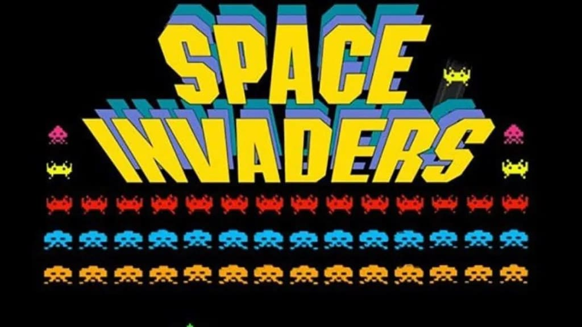
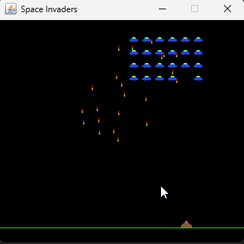

Sourcing Aliens and Lasers
Auke Haanstra
# jfall.
Notes:
Subject slides

Slide 2
Sourcing Aliens and Lasers:
An Eventful Journey Through
Time and Space
Auke Haanstra
# jfall.
Notes:
Subject slides

Slide 3


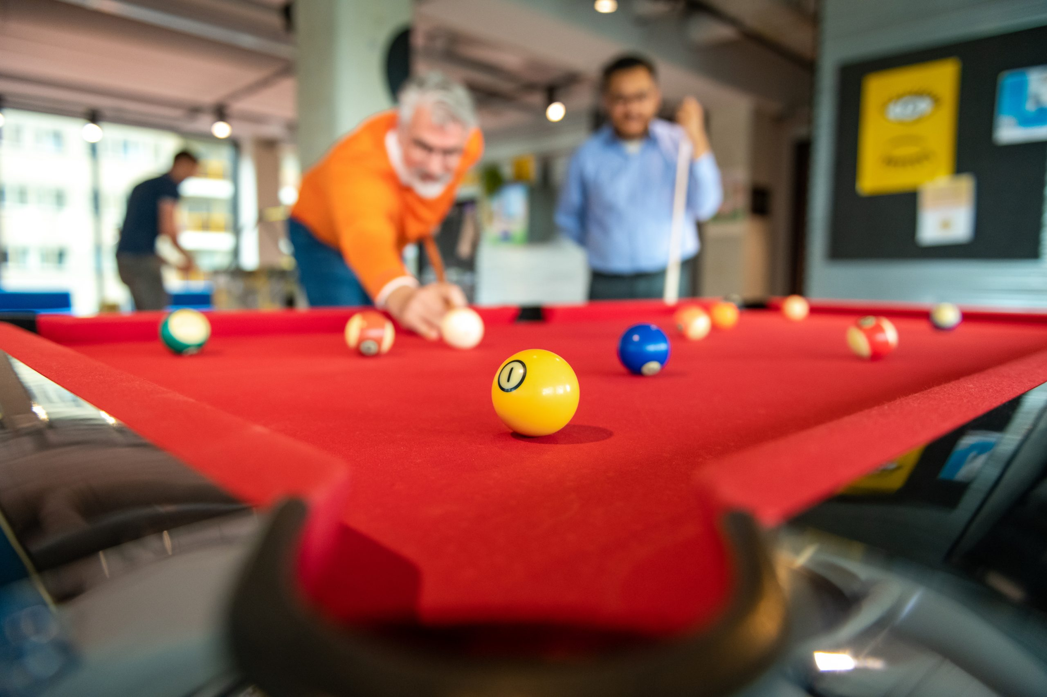
Auke Haanstra ∙ Sourcing Aliens and Lasers
Who am I?
Auke Haanstra, consultant expert level at Pancompany
Expertise: TDD, Architecture
9 years of experience in Java development
More than 100 IT consultants
Notes:
First slide

Slide 4

Auke Haanstra ∙ Sourcing Aliens and Lasers
Contents
Introduction
  Event Modeling
  Event Sourcing
Three slices in Space Invaders
  Move Sprite: State Change Pattern
  Get Game: State View Pattern
  Game Stopper: Automation
Time Travel and Debugging
Conclusion
Notes:
First slide

Slide 5
1. Introduction
# jfall.
Notes:
Subject slides

Slide 6
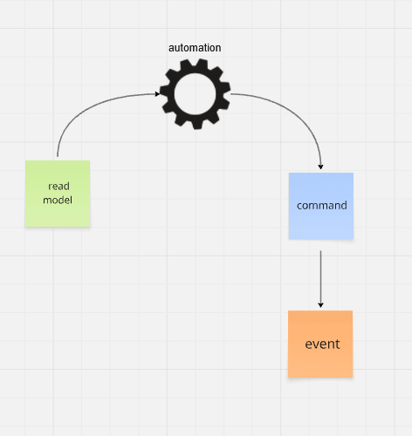
Auke Haanstra ∙ Sourcing Aliens and Lasers
Event Modeling
A method to describe a system
Resembles Event Storming (DDD)
A collaboration of Developers and Business Experts
Focuses on the flow of information
Readable, like a story, on a timeline
Given-When-Then specs for business rules
→ Saves development time
→ Parallel development through vertical slicing
Notes:
First slide

Slide 7
Auke Haanstra ∙ Sourcing Aliens and Lasers
Event Sourcing vs CRUD
CRUD: update & delete old information
In an Event Sourced system
  every piece of information
  every state
  is captured by events
  Never altered or deleted.

Slide 8
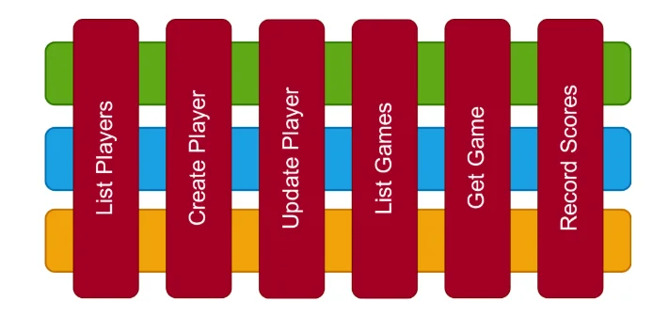
Auke Haanstra ∙ Sourcing Aliens and Lasers
Advantages of event-sourcing
A full history of past events
  Full audit trail
  Time travel & replay
  Debugging & forensics
  Business insight
2. Modularity through vertical slicing and messaging
Evolvable read models through CQRS
Evolvable write models, when using Dynamic Consistency Boundaries (DCB)

Slide 9
2. Three slices in Space Invaders
# jfall.
Notes:
Subject slides

Slide 10
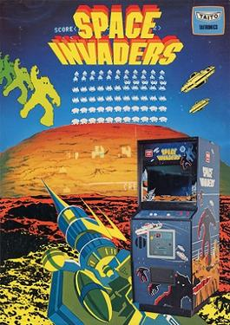
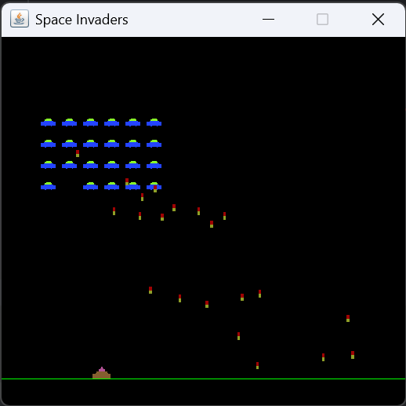
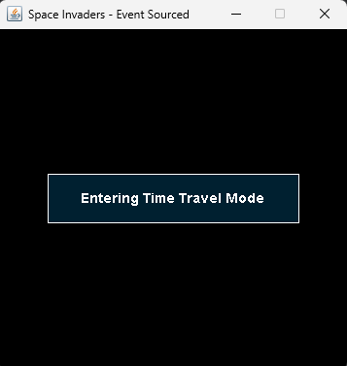
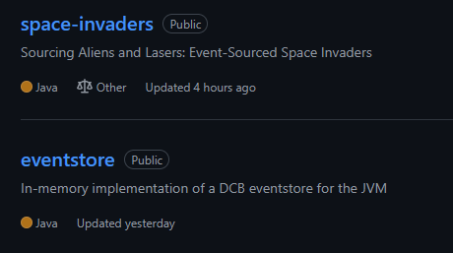
Auke Haanstra ∙ Sourcing Aliens and Lasers
Space Invaders
A playful experiment
& A fun introduction into ES
1978 Tomohiro Nishikado
2019 Jan Bodnar
2025 By me ☺
Notes:
For me: A playful experiment
For you: A fun introduction into Event Sourcing
Tell my questions:
Is it possible to implement a time-sensitive game with Event Sourcing?
Can we achieve time-travel with event-sourcing?
I needed to implement an Event Store first.
I wanted to be flexible, so I chose a DCB event store.
No ready-made solution that supported the speed and time-travel functionality I sought.

Slide 11
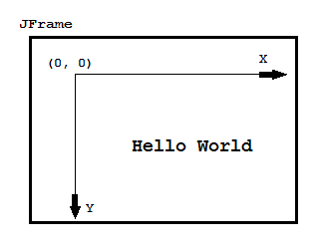
Auke Haanstra ∙ Sourcing Aliens and Lasers
UI technology & terminology
Swing coordinates
Sprites
Notes:
Just some UI technology and terminology we need to understand.

Slide 12
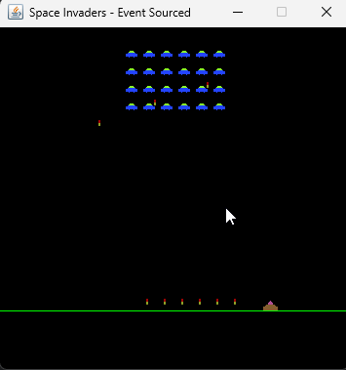
Auke Haanstra ∙ Sourcing Aliens and Lasers
UI technology & terminology
Sprites
Swing coordinates
Notes:
Just some UI technology and terminology we need to understand.

Slide 13
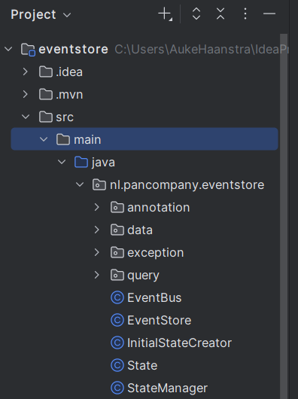
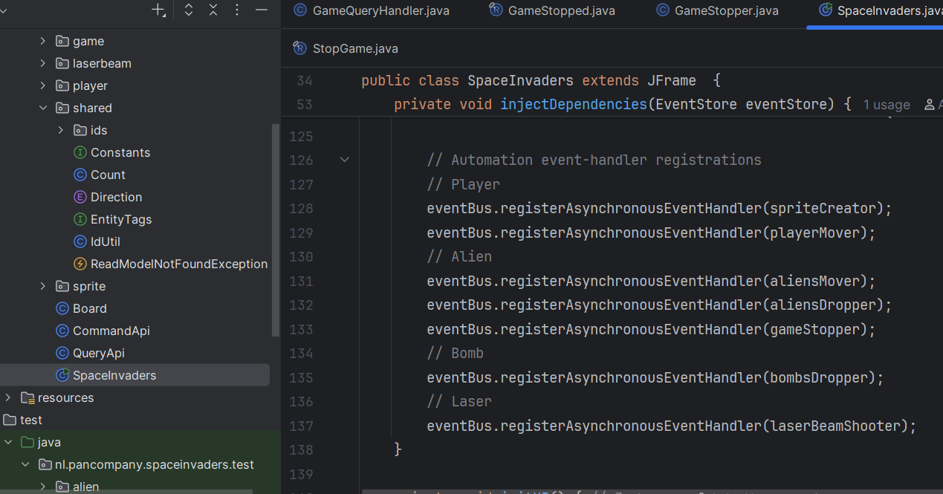

Auke Haanstra ∙ Sourcing Aliens and Lasers
Game code overview

Slide 14
2. (Slice 1) Move Sprite:
State Change Pattern
# jfall.
Notes:
Subject slides

Slide 15
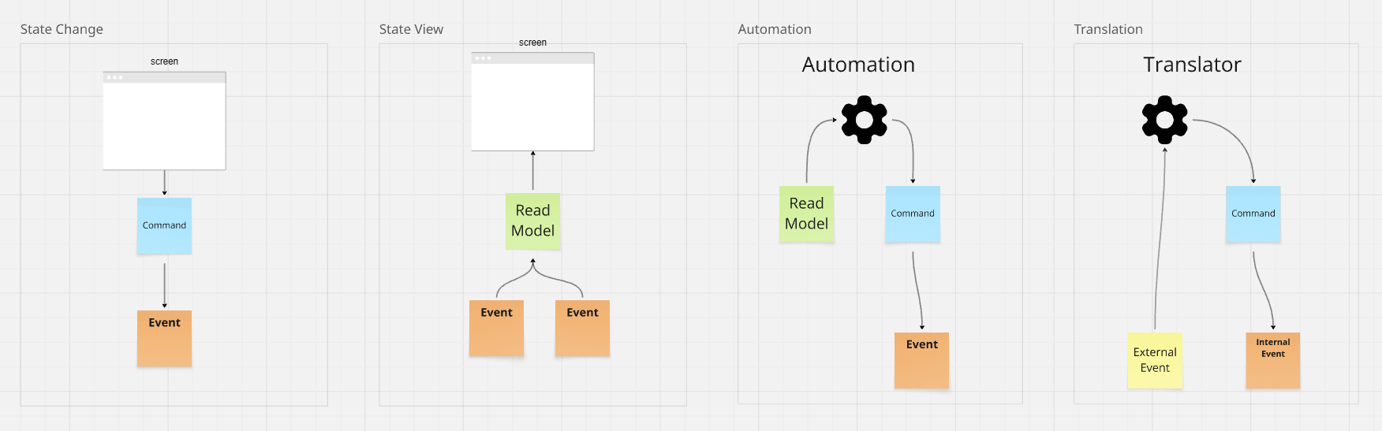
Auke Haanstra ∙ Sourcing Aliens and Lasers
The State Change Pattern
Notes:
First slide

Slide 16
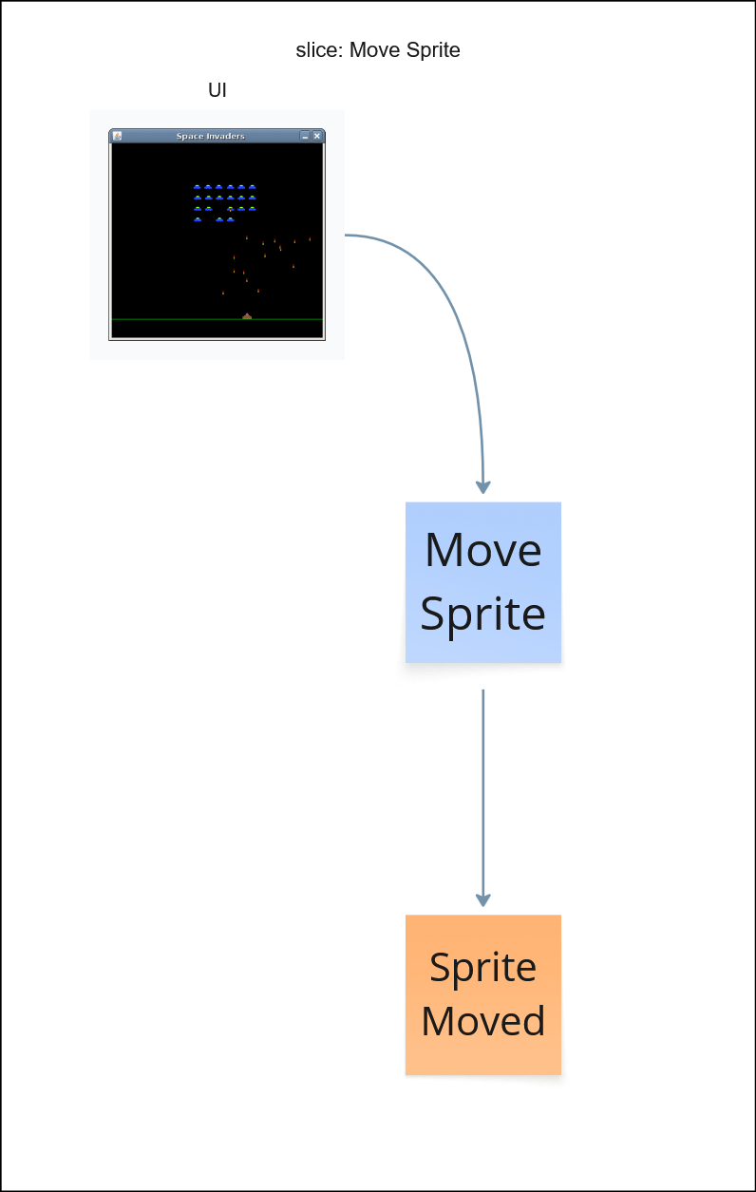
Auke Haanstra ∙ Sourcing Aliens and Lasers
Event Model: Move Sprite
Notes:
First slide

Slide 17
Auke Haanstra ∙ Sourcing Aliens and Lasers
Syntax DCB Eventstore
Sprite
Moved
Game
Alien:3
EventStore.append(
Event.of(alienMoved,
Tags.and("Game", "Alien:3")));
Query.of(Tags.all(), Types.all());
Query.of(Tag.of(“Alien"), Type.of(“SpriteMoved"));
Query.taggedWith("Game", "Alien:3")
.andHavingType("SpriteCreated", "SpriteMoved")
QueryItem laserItem = QueryItem.of("Laser", SpriteCreated.class);
Query.fromItems(laserItem, playerItem);
Append event with tags Game and Alien:3.
EventStore.read(Query query):
All events will match.
Events tagged with “Alien” and having type “SpriteMoved” will match.
Events tagged with “Game” AND “Alien:3” and having type “SpriteCreated” OR “SpriteMoved”will match.
Events tagged with “Laser” of type SpriteCreated.class will match laserItem.
Events matching laserItem OR playerItem, will match.
Notes:
First slide

Slide 18
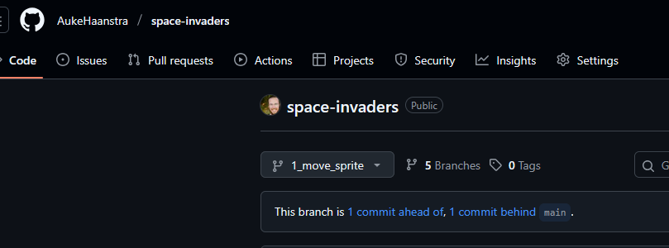
Auke Haanstra ∙ Sourcing Aliens and Lasers
Implementing Move Sprite
Notes:
First slide

Slide 19
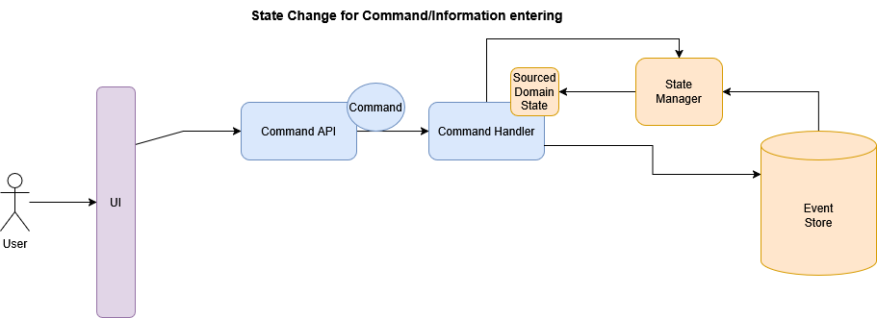
Auke Haanstra ∙ Sourcing Aliens and Lasers
The State Change Pattern: Architecture
Notes:
First slide

Slide 20
2. (Slice 2) GetGame:
State View Pattern
# jfall.
Notes:
Subject slides

Slide 21
Auke Haanstra ∙ Sourcing Aliens and Lasers
The State View Pattern
Notes:
First slide

Slide 22
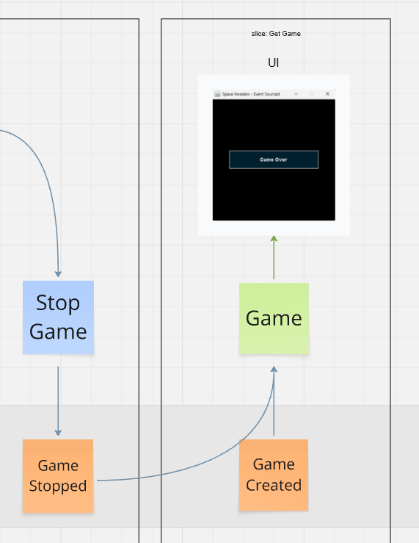
Auke Haanstra ∙ Sourcing Aliens and Lasers
Event Model: Get Game
Notes:
First slide

Slide 23
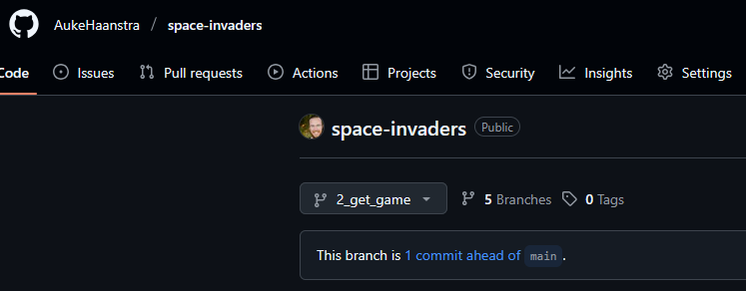
Auke Haanstra ∙ Sourcing Aliens and Lasers
Implementing Get Game
Notes:
First slide

Slide 24
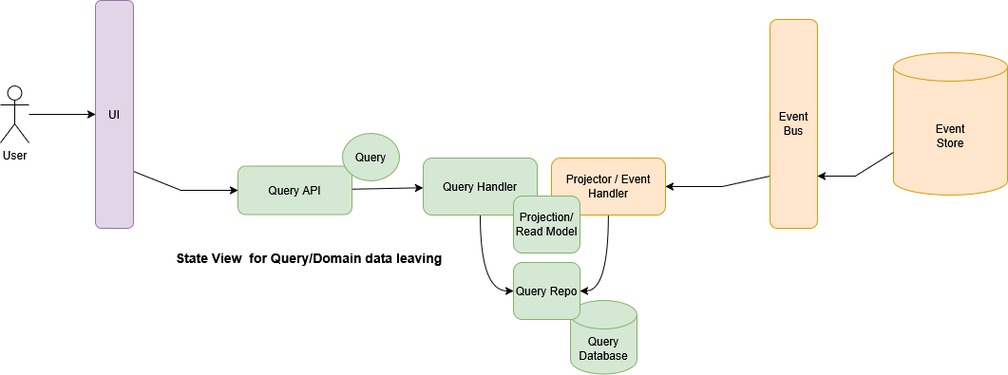
Auke Haanstra ∙ Sourcing Aliens and Lasers
The State View Pattern: Architecture
Notes:
First slide

Slide 25
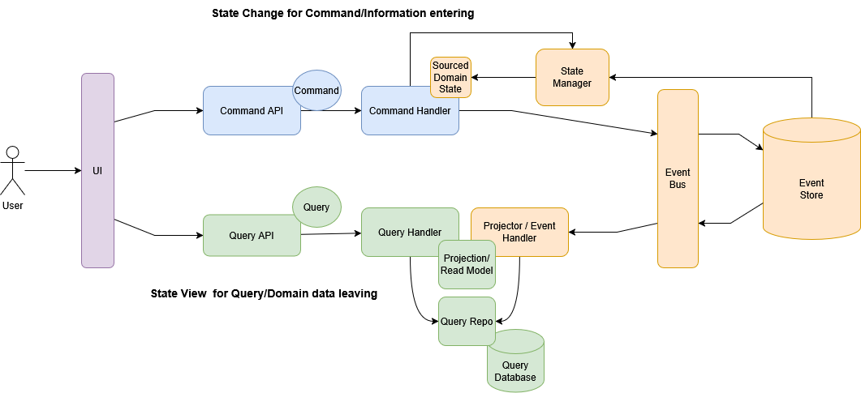
Auke Haanstra ∙ Sourcing Aliens and Lasers
CQRS, Architecture and responsibilities
CQRS!
Notes:
First slide

Slide 26
2. (Slice 3) Game Stopper:
Automation
# jfall.
Notes:
Subject slides

Slide 27
Auke Haanstra ∙ Sourcing Aliens and Lasers
The Automation Pattern
Notes:
First slide

Slide 28
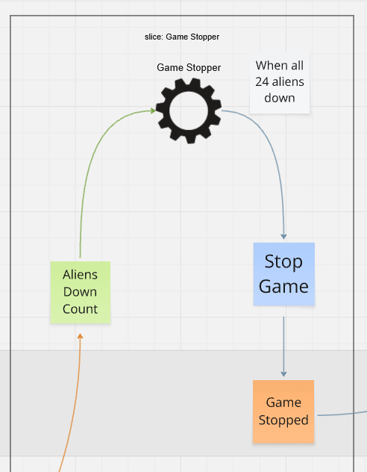
Auke Haanstra ∙ Sourcing Aliens and Lasers
Event Model: Game Stopper
Notes:
First slide

Slide 29
Auke Haanstra ∙ Sourcing Aliens and Lasers
Event Sourcing: Semantics
Command: intend
Command handler: decide
Event: fact/decision
Event handler: react
Command: intend
Notes:
First slide

Slide 30
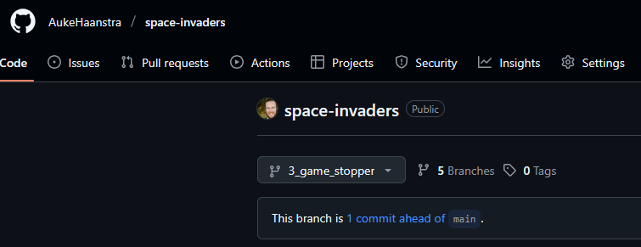
Auke Haanstra ∙ Sourcing Aliens and Lasers
Implementing Game Stopper
Notes:
First slide

Slide 31
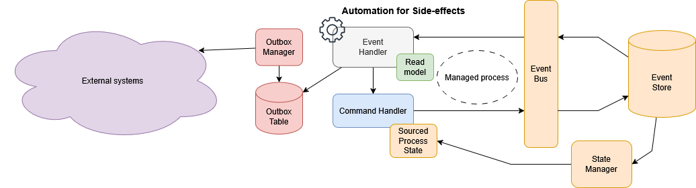
Auke Haanstra ∙ Sourcing Aliens and Lasers
The Automation Pattern: Architecture
Notes:
First slide

Slide 32
3. Time Travel and Debugging
# jfall.
Notes:
Subject slides

Slide 33
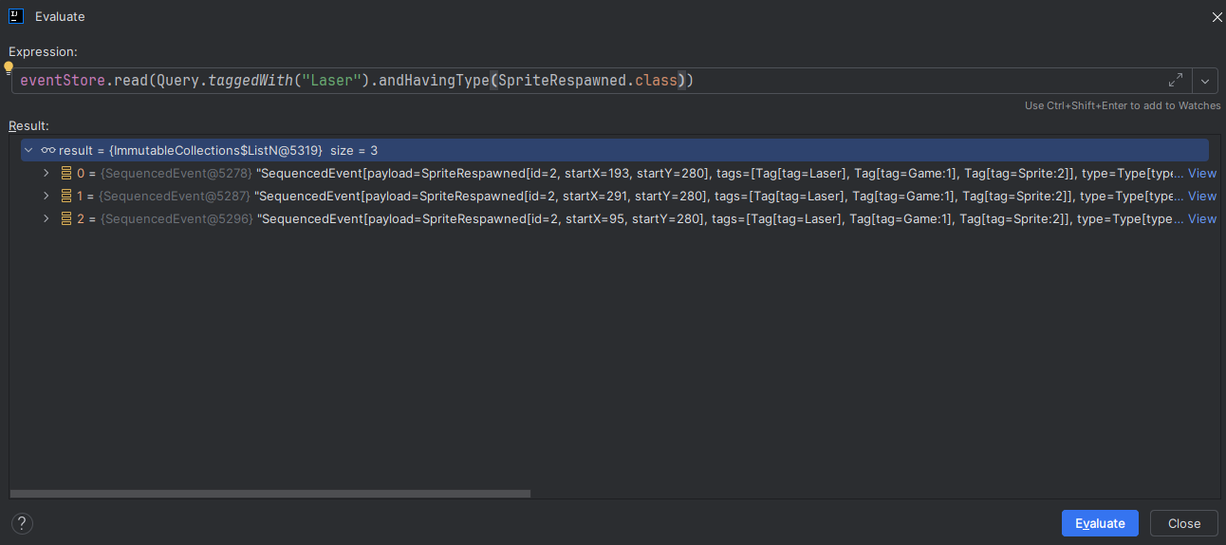
Auke Haanstra ∙ Sourcing Aliens and Lasers
Debugging with Space Invaders
Notes:
Actually found bug here: equals zou enkel op Type.type moeten controleren

Slide 34
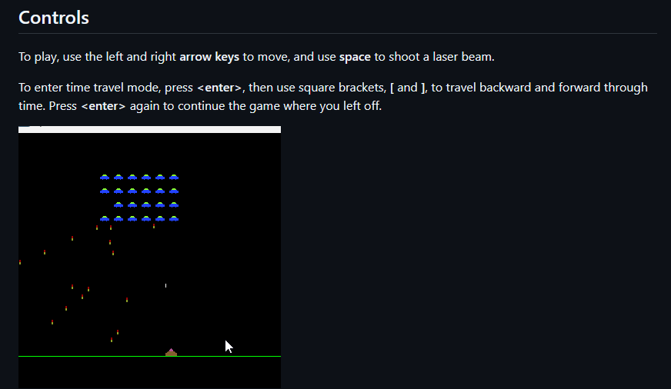

Auke Haanstra ∙ Sourcing Aliens and Lasers
Time Travel with Space Invaders
Notes:
First slide

Slide 35
Auke Haanstra ∙ Sourcing Aliens and Lasers
Time Travel with Space Invaders
Notes:
First slide

Slide 36
Auke Haanstra ∙ Sourcing Aliens and Lasers
Conclusions
You can create a game with Event Sourcing, but...
Eventsourcing at regular game cycles becomes problematic when eventstore size increases
  Snapshotting will be required over longer periods
An event sourced application is very modular
Micro-testing with vertical slices is very easy!
DCB is very flexible and ideal for cross-entity Game rules
Time Travel is really cool and not difficult to use
Notes:
First slide

Slide 37
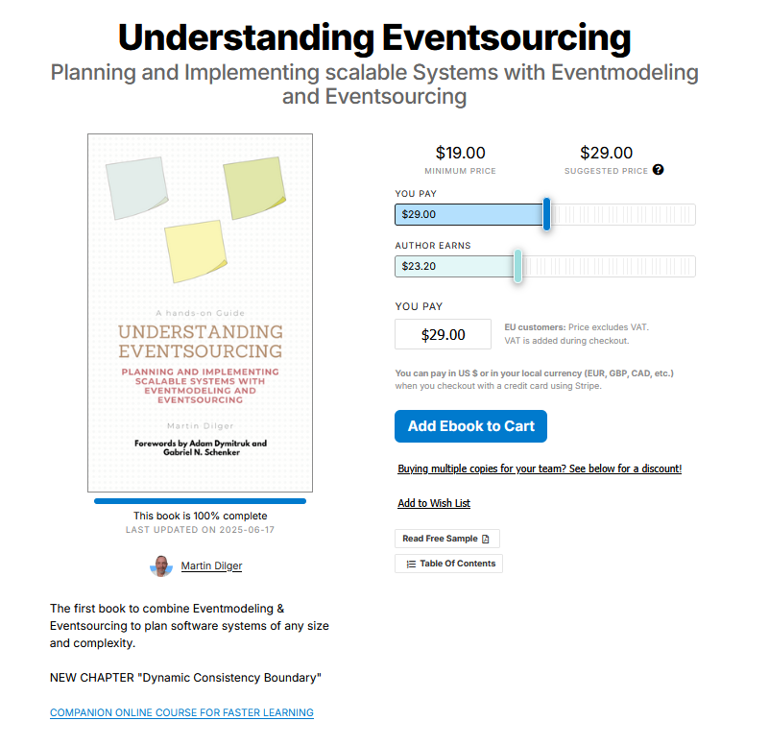
Auke Haanstra ∙ Sourcing Aliens and Lasers
Reading suggestions
Eventmodeling.org
Martin Dilger’s book: Understanding Eventsourcing
https://dcb.events/
Axon Framework and Server, see https://www.axoniq.io/
My GitHub page: https://github.com/AukeHaanstra/
Notes:
First slide

Slide 38


Thanks for your attention
Please rate my session in the J-Fall app
https://github.com/AukeHaanstra
# jfall.
Notes:
Subject slides

Slide 39
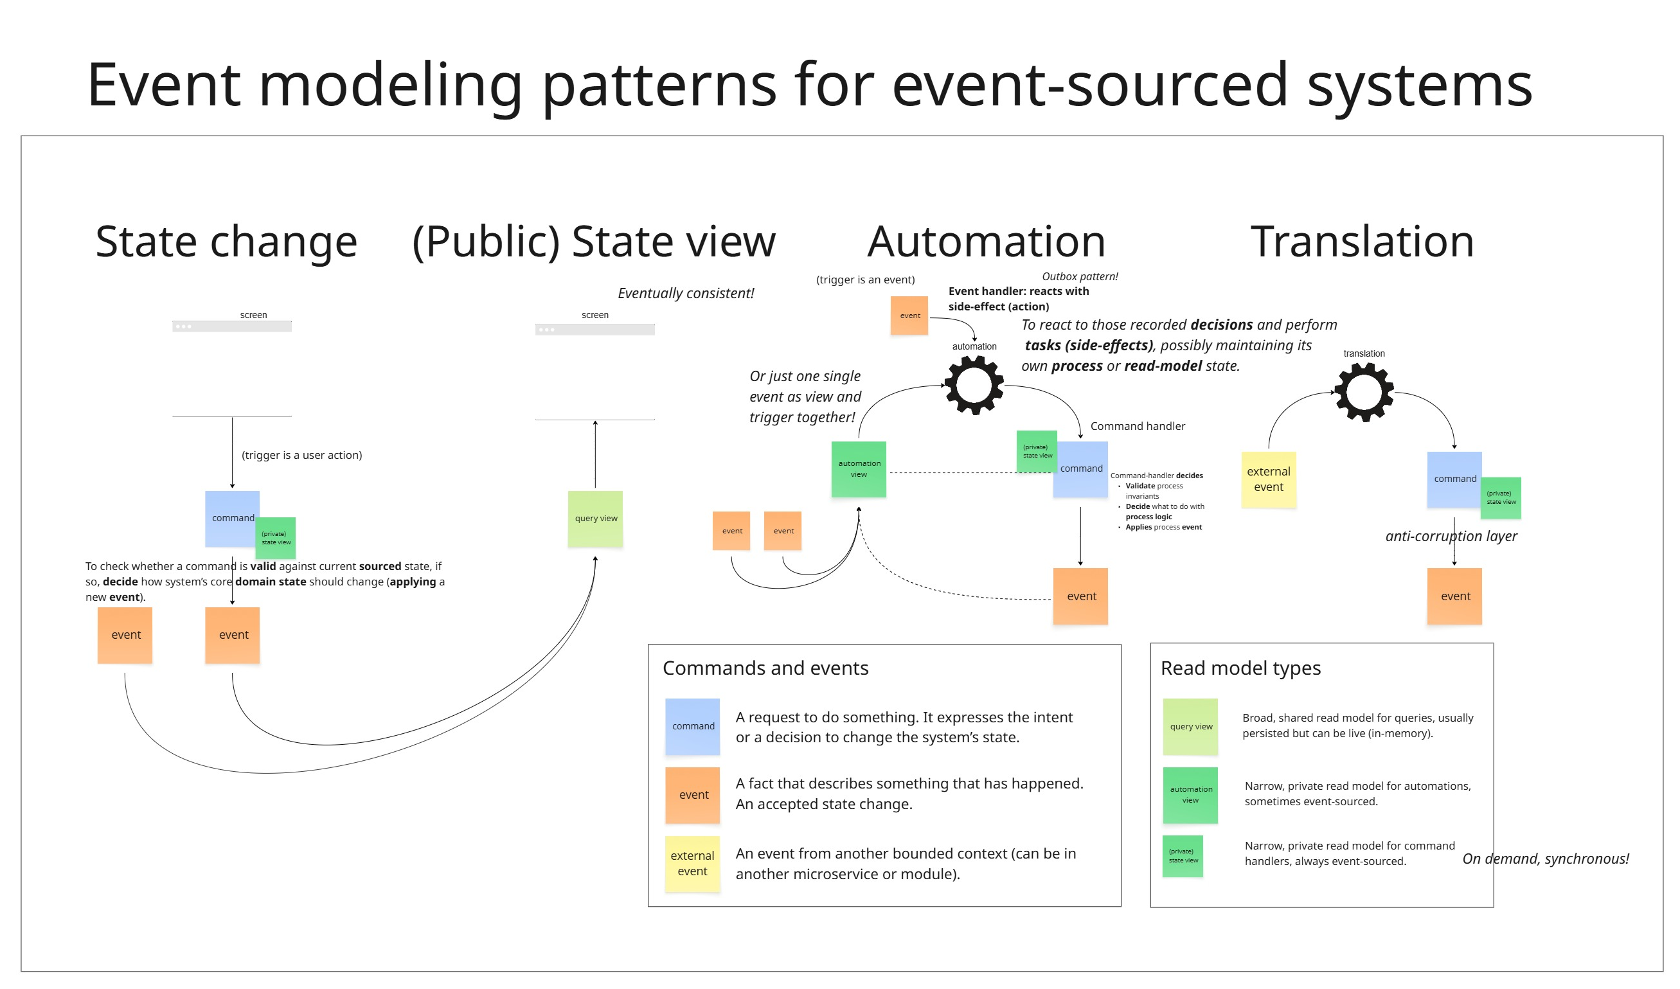
Auke Haanstra ∙ Sourcing Aliens and Lasers

Slide 40
Auke Haanstra ∙ Sourcing Aliens and Lasers
Architecture, patterns and responsibilities
CQRS!
Notes:
First slide

Slide 41
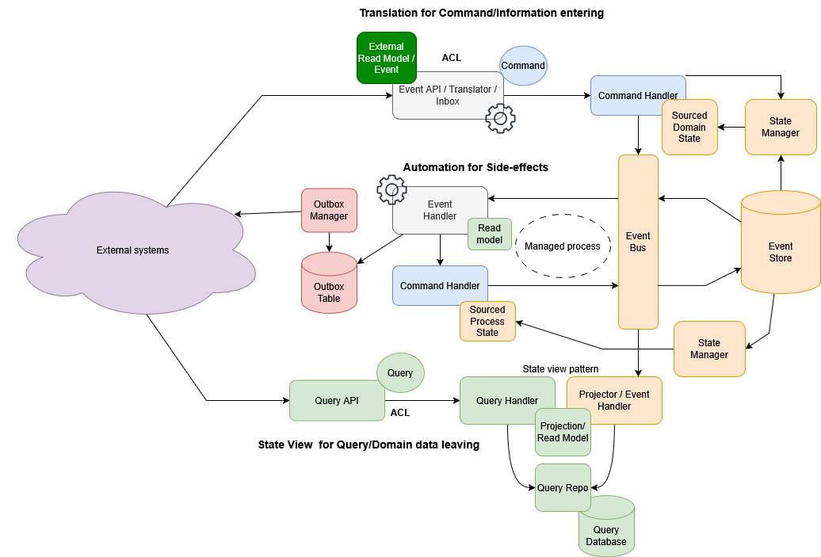
Auke Haanstra ∙ Sourcing Aliens and Lasers
Title
CQRS!

